Slide 1
A multiple regression approach for GWAS and high dimensional inference
Benjamin Chu
Computational Medicine, Biomathematics
1/31/2020

Slide 2
OpenMendel platform for Statistical Genetics
Visit us: github.com/OpenMendel
Was going to talk about this package
Human Genetics (2019): https://link.springer.com/article/10.1007/s00439-019-02001-z

Slide 3
Outline
How simple scientific questions lead to a “high dimensional” data
Pros and cons of “p-value methods” vs multiple regression methods.
Maybe convince you to use Iterative hard thresholding for your high dimensional data
Package: github.com/biona001/MendelIHT.jl
Slides: github.com/biona001/public-talks
Paper: https://www.biorxiv.org/content/10.1101/697755v2

Slide 4



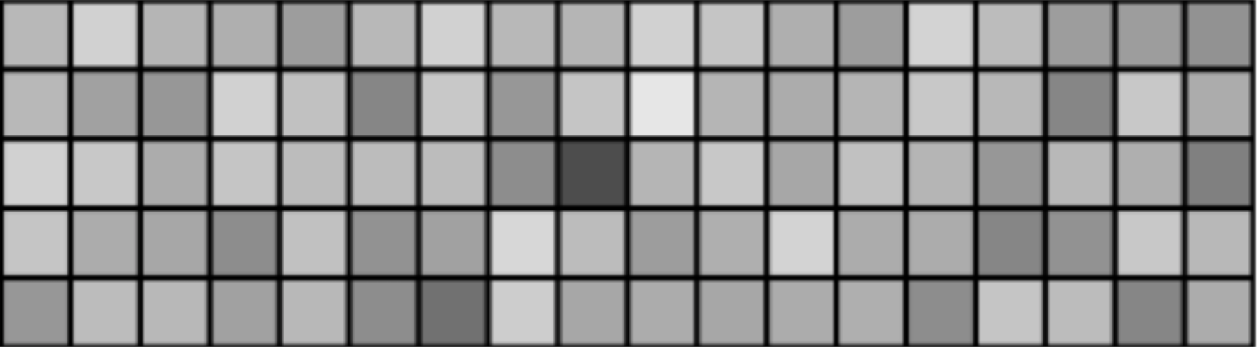
What is high dimensional data?
Dataset with more covariates than samples.
Covariates = independent variables, features, predictors, regressors…
response
covariates
Sample 1
Sample 2
….
Sample 5
e.g. Blood pressure
e.g. sex
, smoking status
, genetics
Figure: https://www.cs.cmu.edu/~ggordon/10725-F12/scribes/10725_Lecture2.pdf

Slide 5
Examples
Imaging: 1000 images, each with 1 million pixel
Netflix: 200,000 users and ~500,000 movies (as of 2010)
Genome wide association study (GWAS): 500,000 samples and 10+ million single nucleotide polymorphisms (SNPs)
To learn anything from these data, we need to:
Identify which covariates are causal
Figure out how much of an effect they exert

Slide 6
Find causal covariates by p-values
Given , fit a (separate) linear regression for each covariate
p = 0.36 (boo)

Slide 7
Find causal covariates by p-values (cont.)
Given , fit a (separate) linear regression for each covariate
p = 0.0000000097 (yay!)

Slide 8
Pros and cons of p-values for GWAS
Pros
Simple to compute (fitting least squares is easy)
Easy to interpret (low p value = good)
Low computational complexity (1 pass for each SNP)
Low memory requirement (since only genotype vectors can be loaded one by one)
Cons:
Assumes all covariates have independent effects. Thus does not control for confounders.

Slide 9
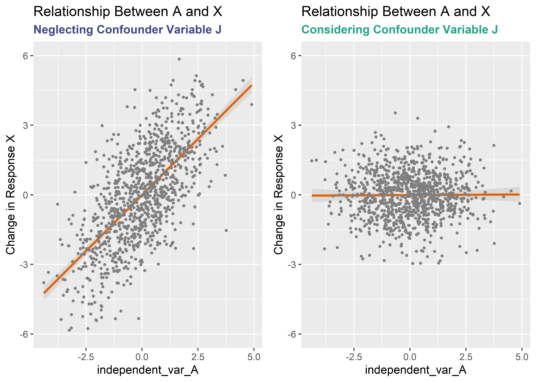
What if you don’t control for confounders?
Figure: https://www.r-bloggers.com/confounders-and-colliders-modeling-spurious-correlations-in-r/

Slide 10
Easy to be mislead when one does not control for confounding
Ideally, every individual is identical except 1 thing:
Model 1:
Model 2:
Message of the talk: Multiple regressions measure covariate effects, as if other covariate effects are fixed.
Notes:
In model 1, we are assuming every individual is completely identical except at the covariate. If this was true, then univariate models are good. In model 2, blood pressure determined by 2 explanatory variables, x1 and x2. Because model 2 contains x2 explicitly, we can measure the effect of x1 on blood pressure, keeping the effect of x2 fixed. In model 1, which puts x2 in the error term, we would have to assume x1 is uncorrelated with x2.

Slide 11
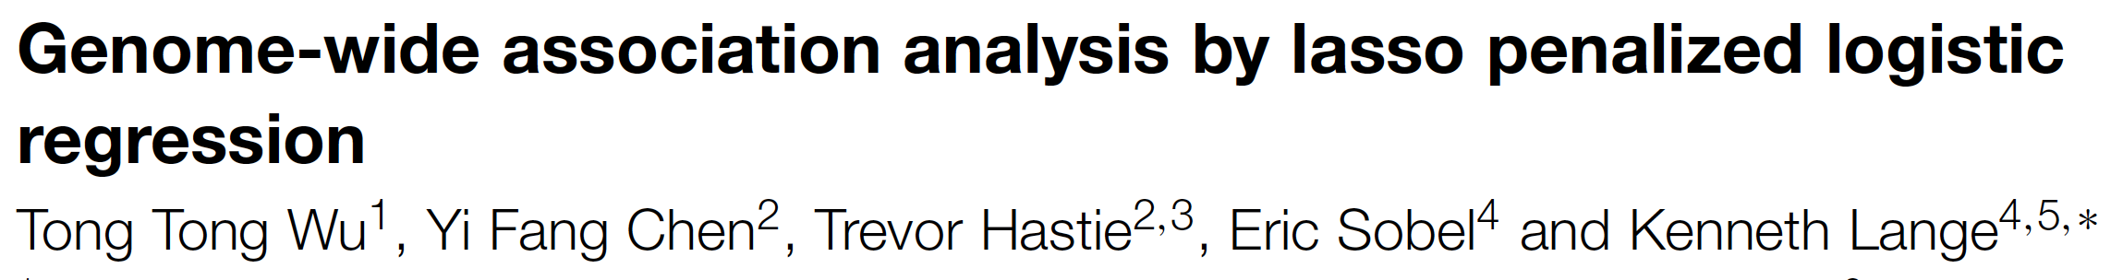
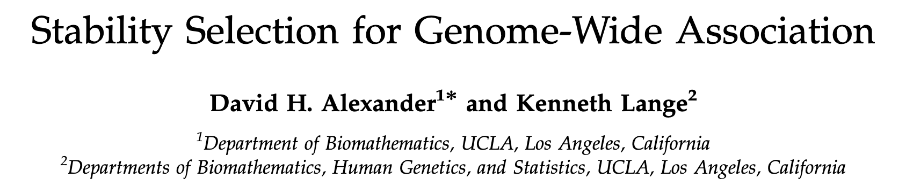
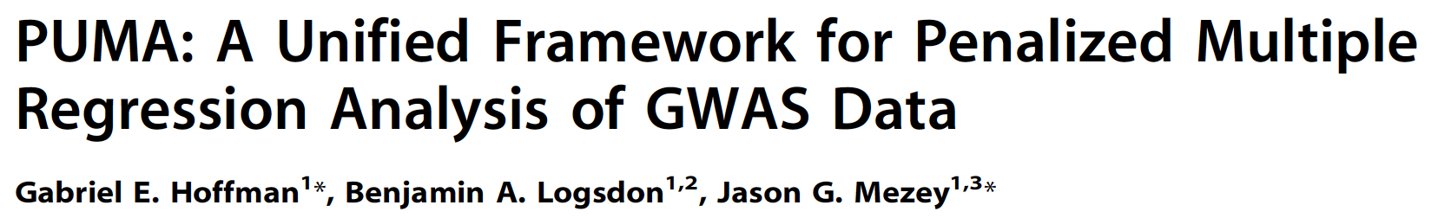
What are some multiple regression methods and do they work in GWAS?

Slide 12
Lasso finds too many false positives because of shrinkage

